Slide 1
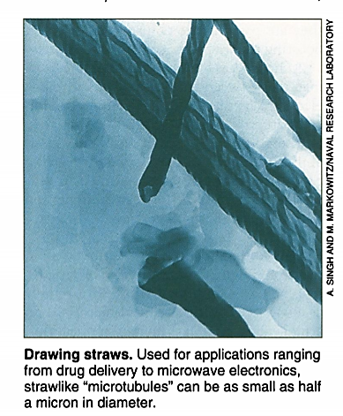
Self Assembly- Applications:
2) The Tubular Route
Spheres aren't the only structures that phospholipids can form.
Lipids other than PC have features that cause them to assemble into tubes that resemble microscopic soda straws.
And the ability of these "microtubules" to form spontaneously allows researchers to explore materials that would be less time consuming and expensive.

Slide 2
Applications:
2) The Tubular Route
Tubule-forming phospholipids such as diacetylenic lipids have a slightly different shape than sphere-forming phospholipids like PC.
NRL's Schnur with his colleague Jonathan Selinger worked out a model of microtubule formation.
According to this model, when these phospholipids begin stacking in bilayers, the molecules' asymmetrical shape keeps them from forming a sphere and forming a long, narrow strip.

Slide 3
Applications:
2) The Tubular Route
The disjointed packing within the bilayer then causes each strip to curl, rather like a spiral staircase.
Attraction between intermolecular forces at the edges winds the staircase tighter until the edges fuse to form a tubule.

Slide 4
Applications:
2) The Tubular Route
Once formed, these tubules can then be stuffed with a Jello like polymer matrix containing drugs or other chemicals that will slowly drain out, as the polymer is porous.
Further two biologists, Alan Rudolph and Barry Spargo used this strategy to turn microtubules into timed-release drug capsules.
In animal studies, they showed that tubules stuffed with the polymer matrix and a cell growth factor called transforming growth factor, when placed at the site of a wound, would slowly release the growth factor for up to 5 days, speeding wound healing.

Slide 5
Applications:
2) The Tubular Route
The microtubules also make dandy microscopic templates when coated with metals, they are stronger and have useful electronic properties.
Physicists Ranganathan Shashidhar of NRL and Eric Cross of Pennsylvania State University explored the use of nickel and permalloy tubules to reduce the electromagnetic interference between adjacent microchips in ultra dense circuit boards.

Slide 6
Applications:
2) The Tubular Route
Such microchips constantly give off and absorb electromagnetic waves, like radio waves and microwaves.
If strong enough, the electromagnetic waves given off from one chip can disrupt the operation of its neighbors .
The need to miniaturize components by packing the chips closer together boosts the interference between chips.
Therefore, the method employed was placing small pieces of material between each chip to block the electromagnetic fields and microscopic rods of metal were ideal for this, given their long thin shape that enhances their ability to block electromagnetic waves.

Slide 7
Applications:
3) Sheets and sandwiches
Electronics applications are also driving researchers to experiment with self-assembly as a way of layering sheets of materials, an arrangement that has myriad applications.
Laying down successive single-atom-thick layers of semiconductor materials for devices such as laser diodes by molecular beam epitaxy machine to "spray paint" molecular layers is a costly process.
Self-assembly has an advantage over this. The molecular building blocks are chosen so that they can only combine in a single-layered arrangement.
Technique to layer electronically active materials for devices such as solar cells and light-emitting diodes (LEDs).

Slide 8
Applications:
3) Sheets and sandwiches
To make such self-assembled sandwiches in such a way that each layer serves as a surface for the next layer.
In 1988, Mallouk first did this by layering a series of molecules on a gold-plated silicon bed.

Slide 9
Applications:
3) Sheets and sandwiches
He started by dipping this base into a solution containing molecules with a sulfur atom at one end, a hydrocarbon chain in the middle, and a phosphonate group at the end .
The sulfur atoms tightly bonded to the gold surface, leaving phosphonate groups sticking out at the surface.
These phosphonates carry a net negative charge.
Then the structures was placed in a bath containing zirconium ions, which have a positive charge.
The zirconium bonded to the phosphonates, forming a single-atom thick layer of sheet metal.

Slide 10
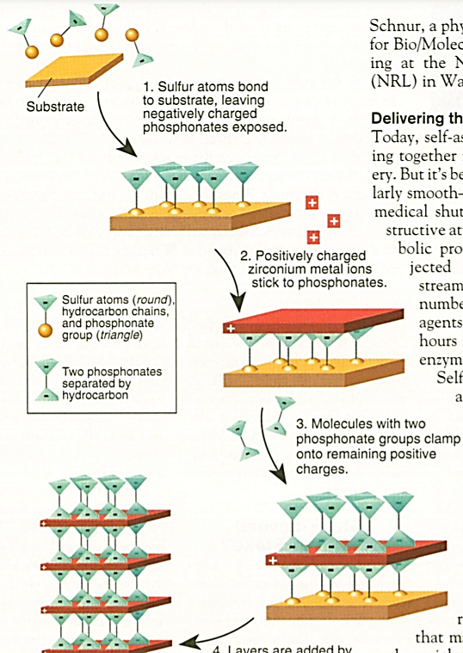
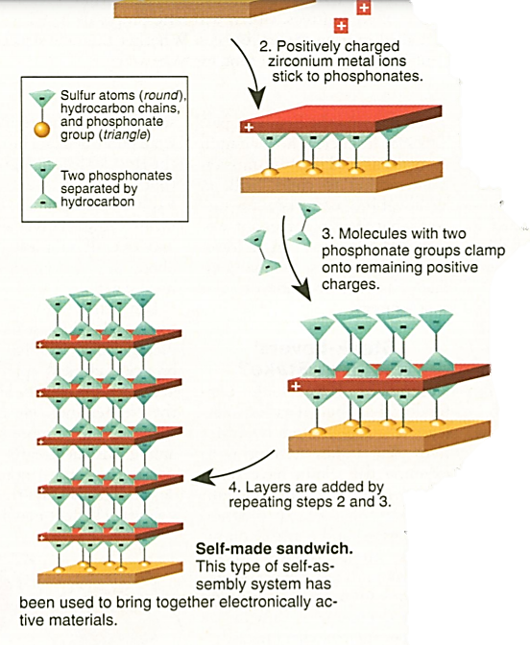
Then the structures was dipped in a bath containing molecules with phosphonate groups at both end, which readily bound to the zirconium, leaving another group of unbound phosphonates sticking out at the top.
From there simply the process was repeated, building layer after layer.

Slide 11
Applications:
3) Sheets and sandwiches
Layered structures are essential for semiconductor devices, which work by separating opposite electric charges between different layers, or different levels of the same layer.
In conventional solar cells, silicon atoms capture photons, emitting negatively charged electrons and positively charged "holes”.
Effectively due to the absence of an electrons, the opposite charges migrate to the top and bottom of the silicon layer, where they are collected and shuttled to a battery for storage.
If the charges recombine before reaching the battery, the result is heat instead of electricity.

Slide 12
Applications:
3) Sheets and sandwiches
In 1992, Howard Katz and his colleagues at AT&T used Mallouk's "metalphosphonate" self-assembling system to emulate part of a solar cell.
They began by depositing several layers of organic molecules, known as porphyrins and vilogens.
Like silicon, porphyrin molecules capture sunlight, giving off electrons and holes.
Here in the device the porphyrins donate the electrons to the vilogen molecules, allowing the charges to remain separate.

Slide 13
Applications:
3) Sheets and sandwiches
self-assembled layers hold the promise of drastically reduce the manufacturing cost of solar cells.
Further research is going on with self-constructing layers as possible routes not only to solar cells but to LEDs, which run the same reaction in reverse, combining opposite electric charges and emitting light.

Slide 14
Constructing the field
Further Applications:
Researchers are trying to get self assembling molecules to aid in orienting liquid crystal polymers for optical displays.
And, in making nonlinear optical materials, which are essential for routing optically transmitted data.

